Slide 1
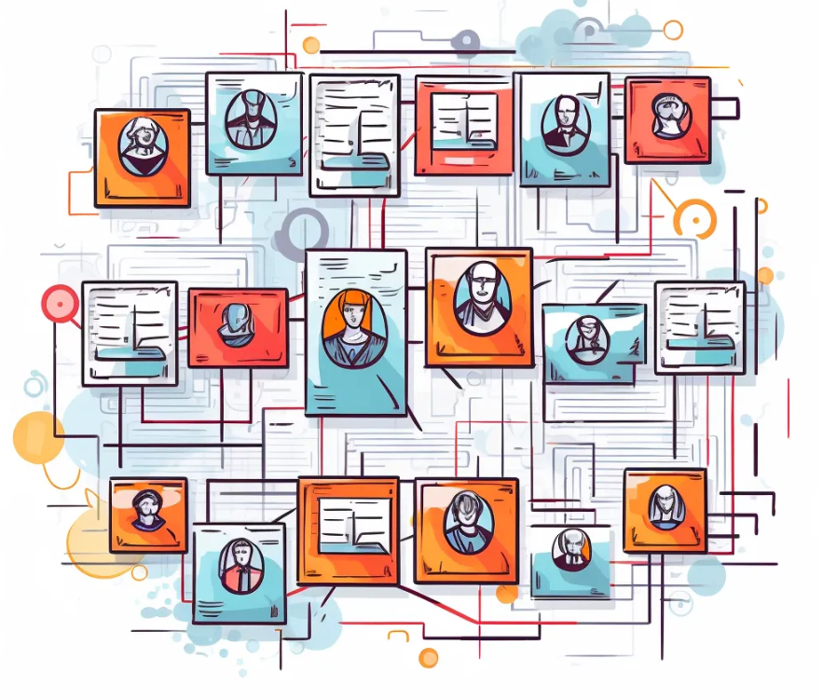
Title: Graph Generation Using LLM Subtitle: Processing Text Files to Extract Entities and Relationships Sahil Pamnani, Aniket Poojari 6 June,24

Slide 2
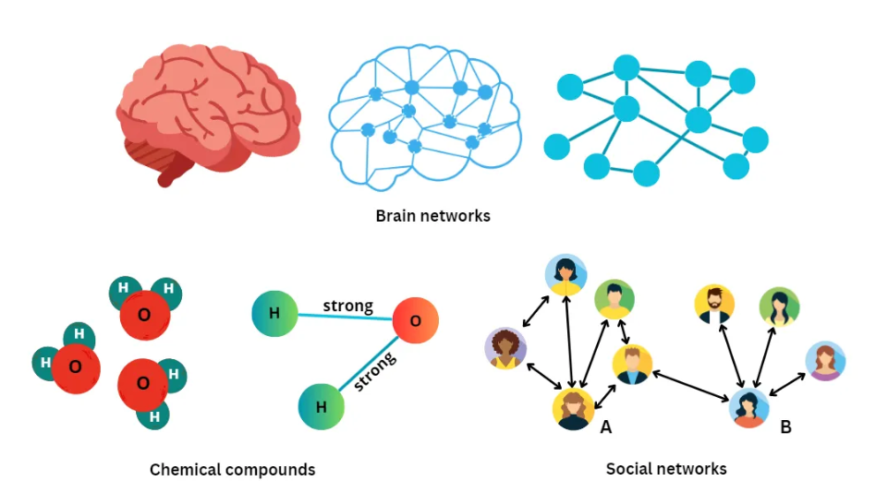
Title: Introduction
Content:
We have text files containing important information.
We want to extract specific information (entities) and their relationships.
We will use the OpenAI API to automate this extraction.

Slide 3
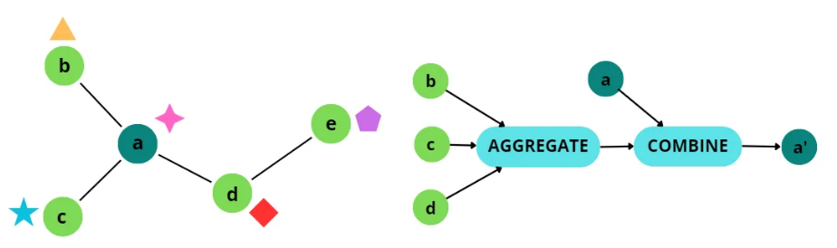
Title: Overview of the ProcessContent:
Load environment variables and set up OpenAI API.
Process individual files to extract information.
Aggregate extracted information into structured JSON format.

Slide 4

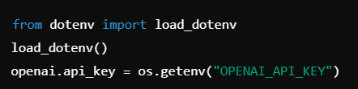
Title: Step 1: Loading Environment Variables
Use dotenv to load environment variables.
These variables include OpenAI API credentials and settings.
Example:

Slide 5
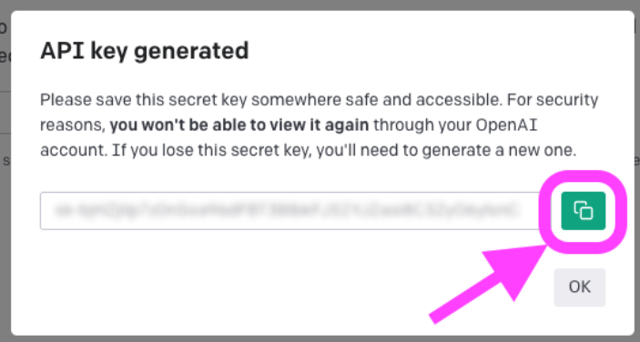
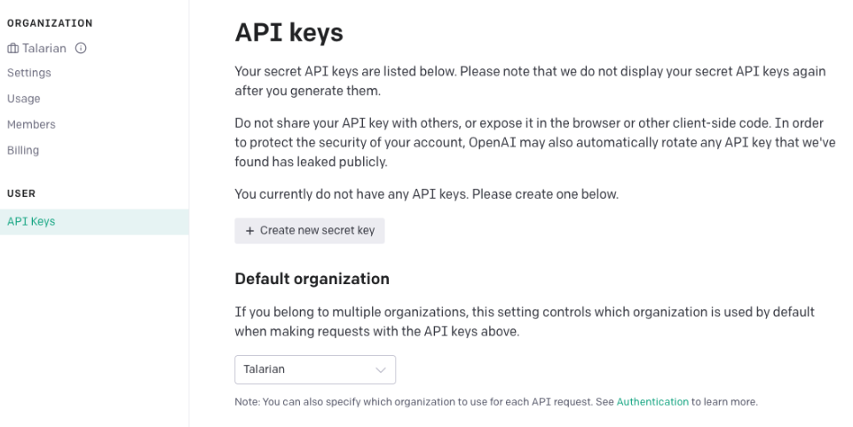
Step 2: Setting Up OpenAI API
Configure OpenAI API with necessary details:
API key
API base
API version
Deployment name

Slide 6
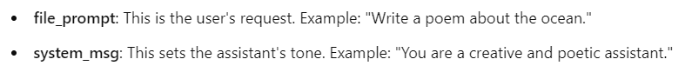
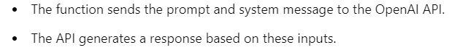
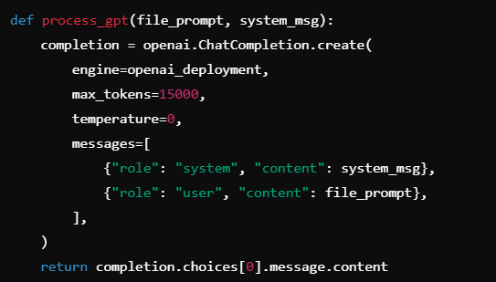
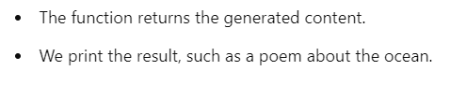
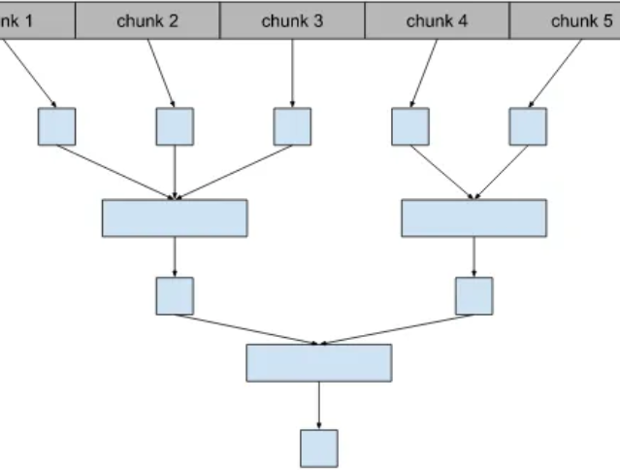
Title: Step 3: Processing Individual Files
1. Defining the Prompt and System Message:
2. Calling the process_gpt Function:
Content:
Function process_gpt sends a prompt to OpenAI API and gets the response.
3. Calling the process_gpt Function:

Slide 7
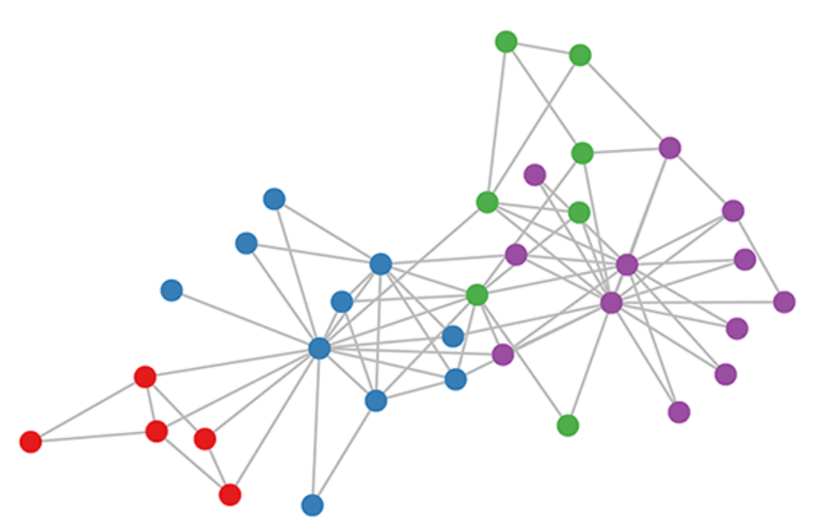
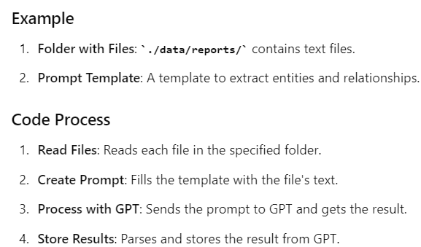
Step 4: Extracting Entities and Relationships
Function extract_entities_relationships processes files in a folder.
Reads file content, creates prompt, calls process_gpt, and collects results

Slide 8
Example in Detail
Folder: ./data/reports/ contains:
report1.txt: "Alice went to Paris."
report2.txt: "Bob works at Google."
Prompt Template: “Extract entities and their relationships from the following text: ${ctext}”
For report1.txt, the becomes:
Extract entities and their relationships from the following text: Alice went to Paris.

Slide 9

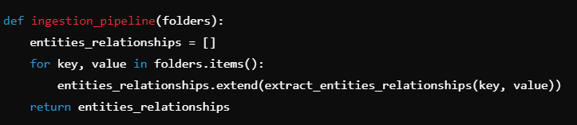
Step 5: Running the Entire Pipeline
Function ingestion_pipeline processes multiple folders.
Uses provided templates to extract information and aggregates results.
This Python function ingestion_pipeline takes a dictionary of folders as input, iterates over each folder, extracts entities and relationships from the contents, and returns a list of all entities and relationships found across all folders.

Slide 10
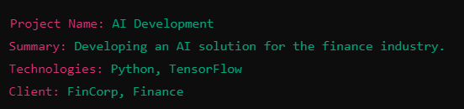
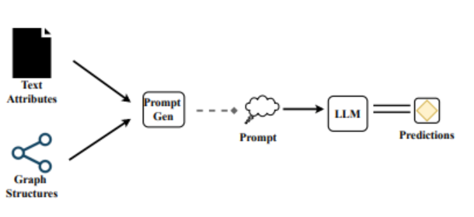

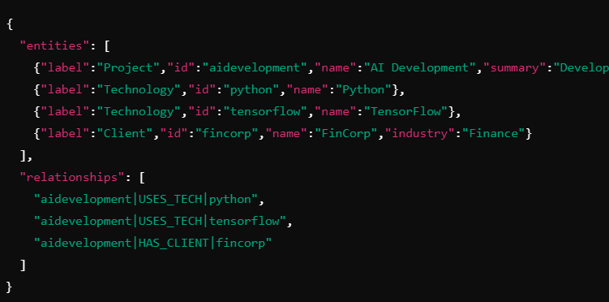
Example 1: Project Briefs
Input (File Content):
Output:

Slide 11
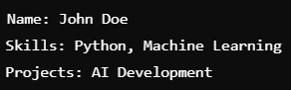

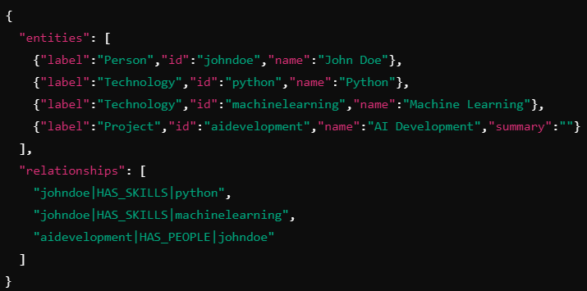
Example 2: People Profiles
Input (File Content):
Output:

Slide 12
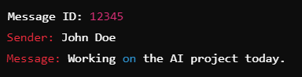
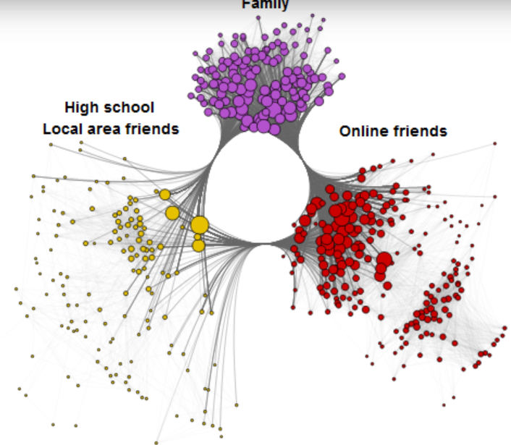
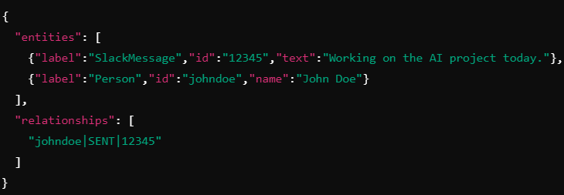
Example 3: Slack Messages
Input (File Content):
Output:

Slide 13
Conclusion:
The code automates the extraction of structured information from text files.
01
It uses the OpenAI API to identify entities and their relationships.
02
This structured data can be used for various purposes, such as project management, HR analytics, and communication analysis.
03

